Slide 1
Advance Database Management System SQL Server Data Tools Meghashree Maddihally Nagoji

Slide 2
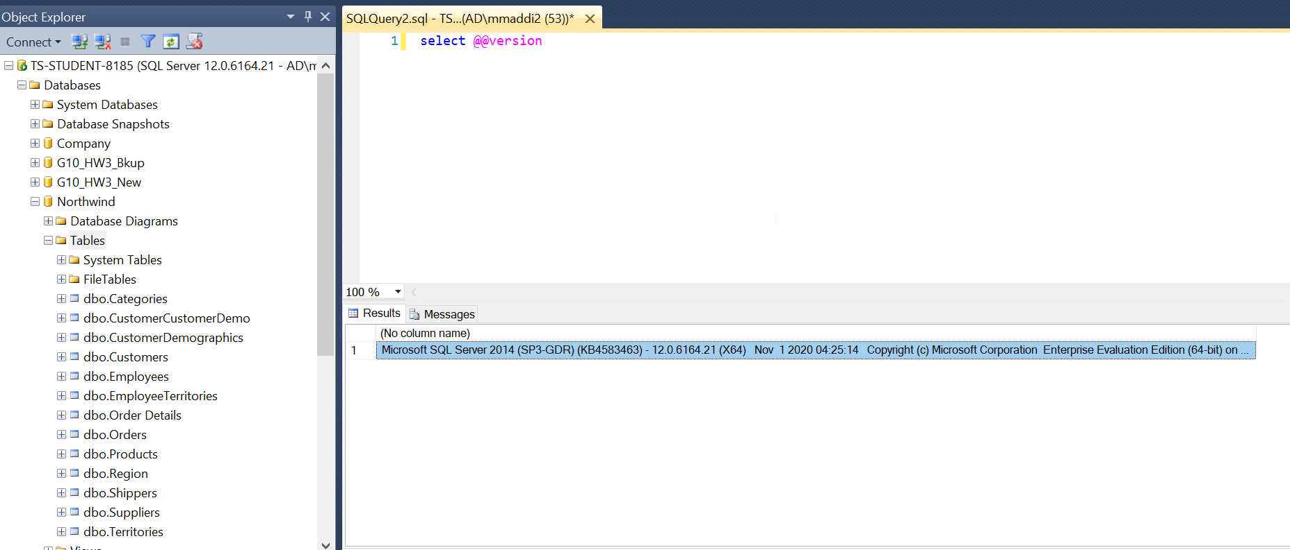
Verify if SQL Server 2014 is already installed?
Run the below SQL query in the query window of SSMS:
select @@version
Outputs the version of the installed SQL Server

Slide 3
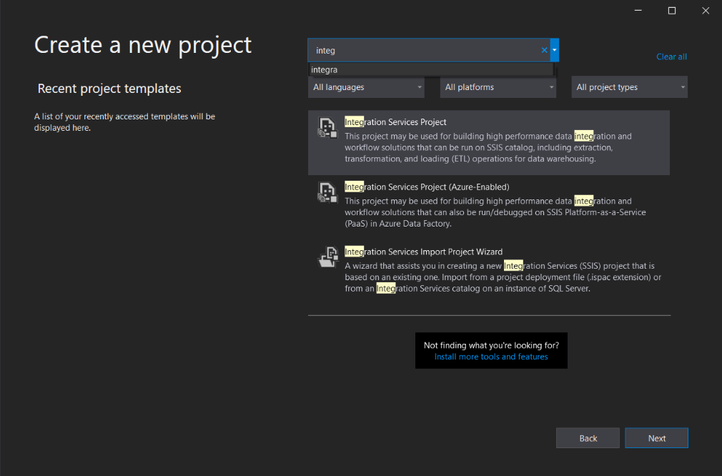
Create a New Project in SSIS
Search for Visual Studio and Create New Integration Service Project
Integration Services can extract and transform data from a wide variety of sources such as XML data files, flat files, and relational data sources, and then load the data into one or more destinations
SQL Server provides a single setup program to install any or all its components, including Integration Services. Use Setup to install Integration Services with or without other SQL Server components on a single computer.
Similar is the case with Visual Studio which provides single setup program and can connect to SQL Server.

Slide 4
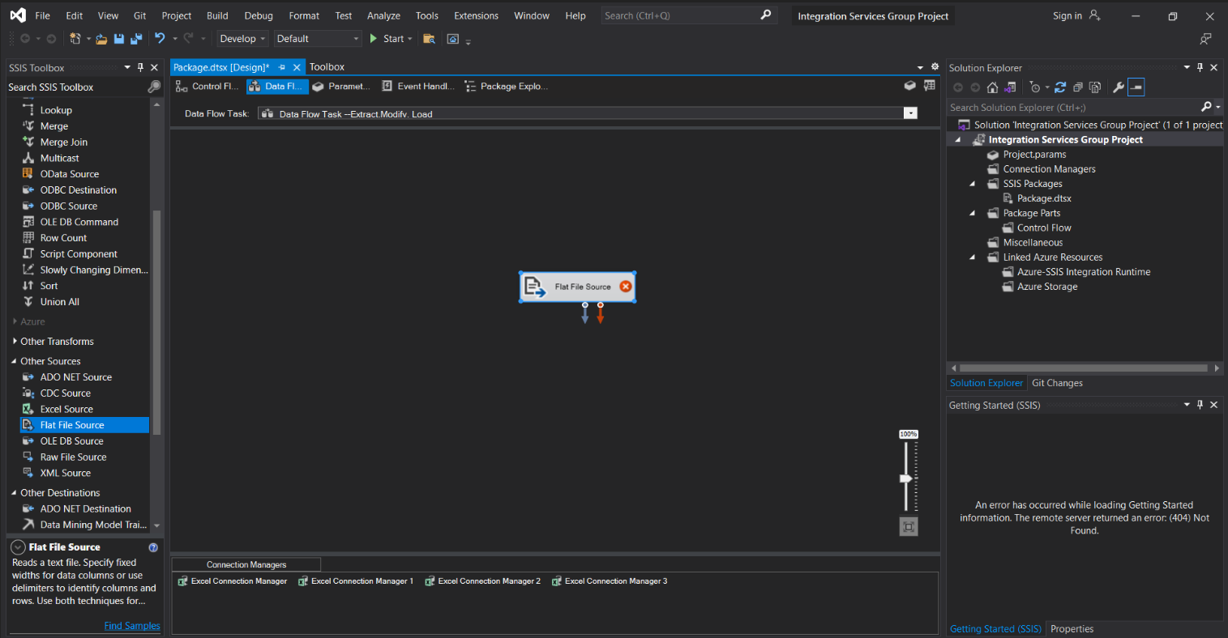
Control Flow and Data Flow in SSIS
The template is organized into 5 tabs, with Control Flow & Data Flow being the most used ones.
The control flow is created by dragging sequence containers and control flow tasks from the SSIS toolbox onto the designer surface. The Control Flow tab, as the name implies, lets you control the flow of your data
Data flow tasks encapsulate the data flow engine and are specialized for transferring data from one location to another

Slide 5
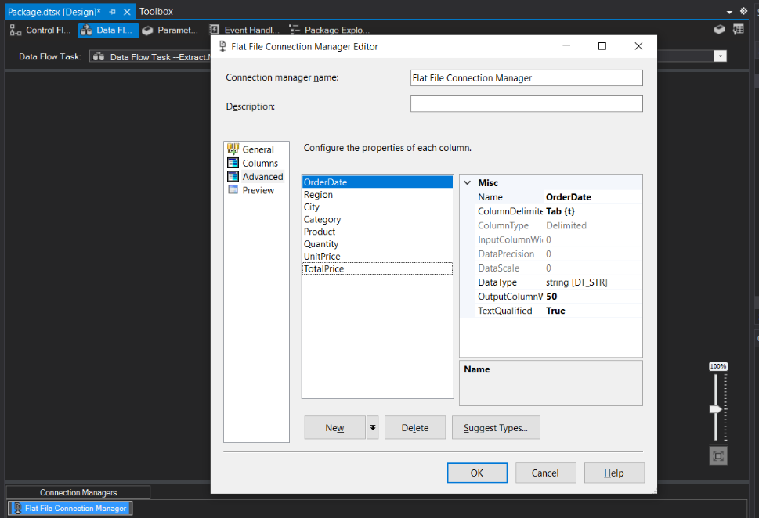
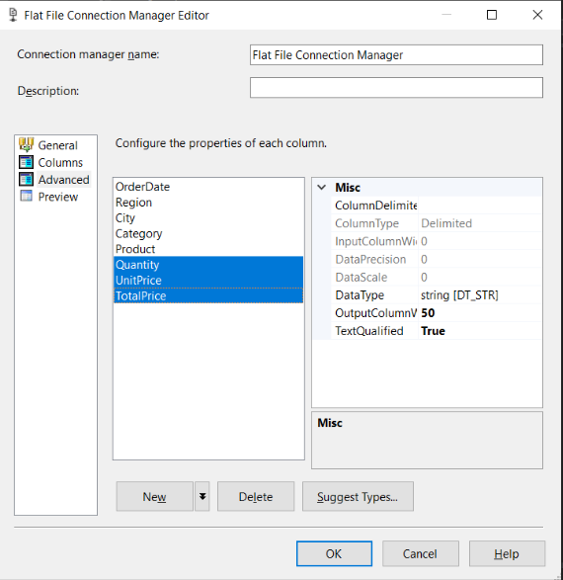
Data Flow Extract in SSIS
In an SSIS task data flows from at least one source component to at least one destination component
Data Flows are configured by selecting the proper data source and destination components that match the type of connection manager objects in your SSIS package. If you are using an OLE DB connection in your SSIS package, use a corresponding OLE DB Source component.

Slide 6
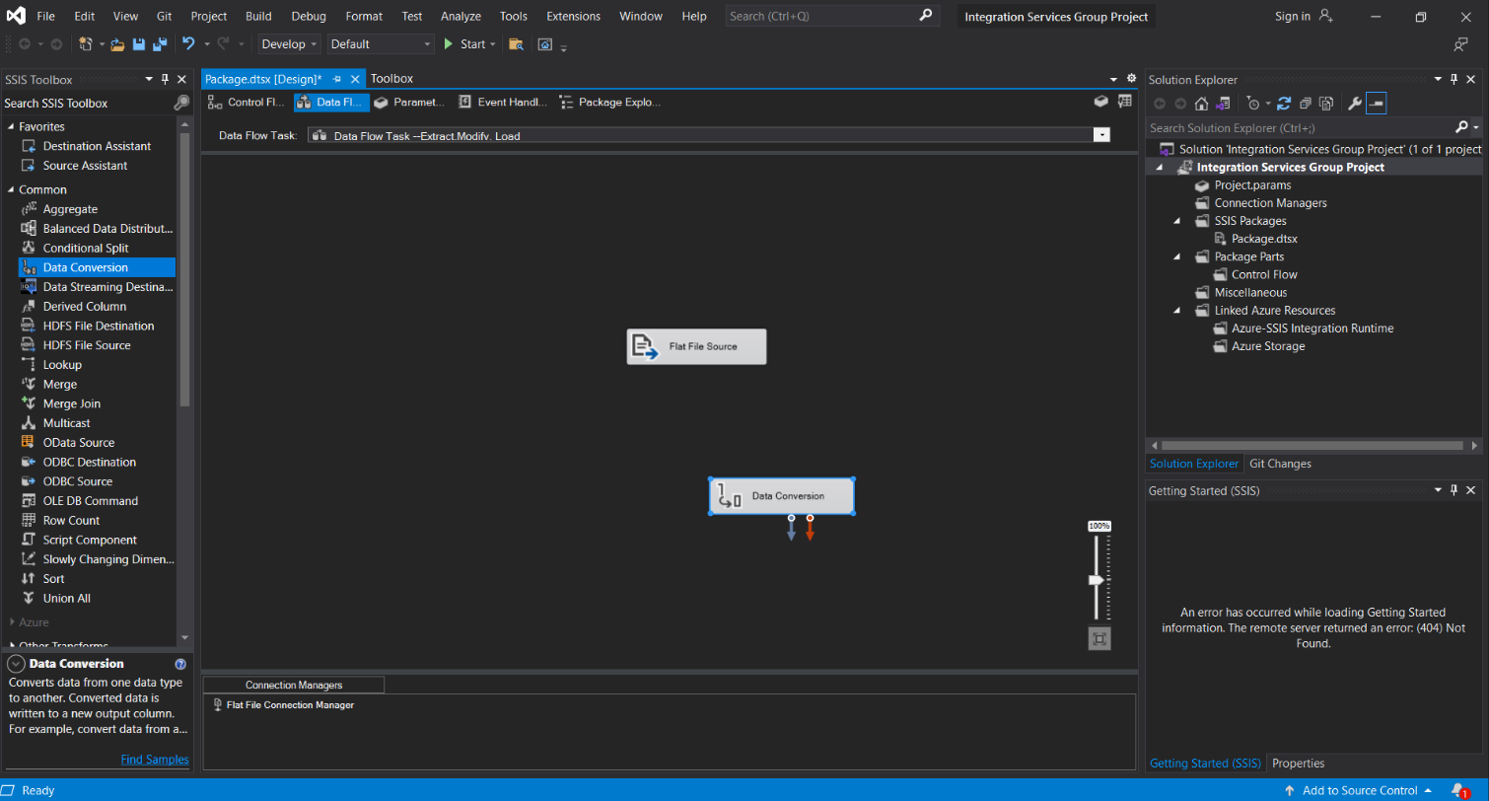
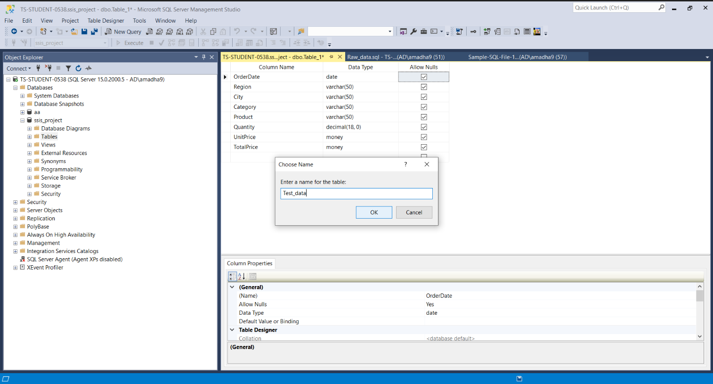
Data Flow Transform in SSIS
In an SSIS task data flows transformation for useful information.

Slide 7
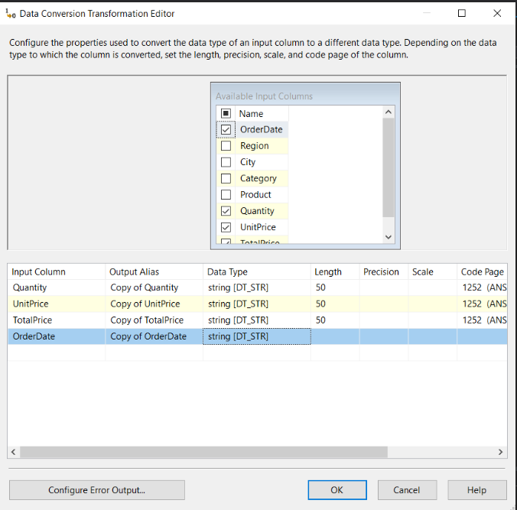
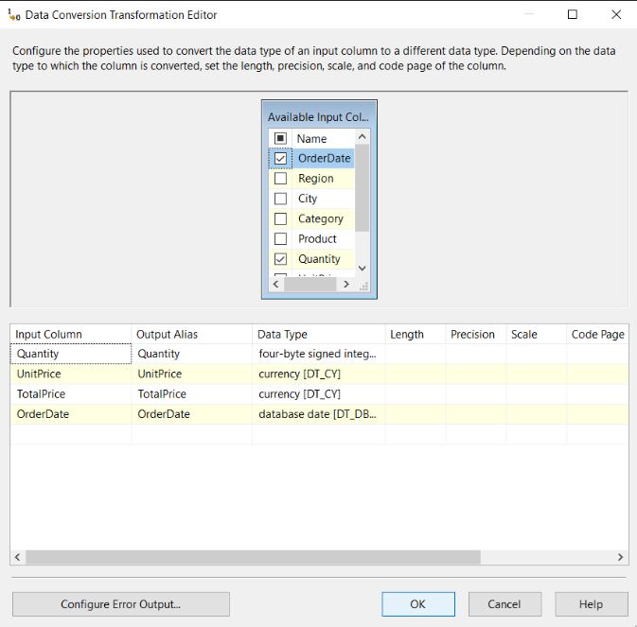
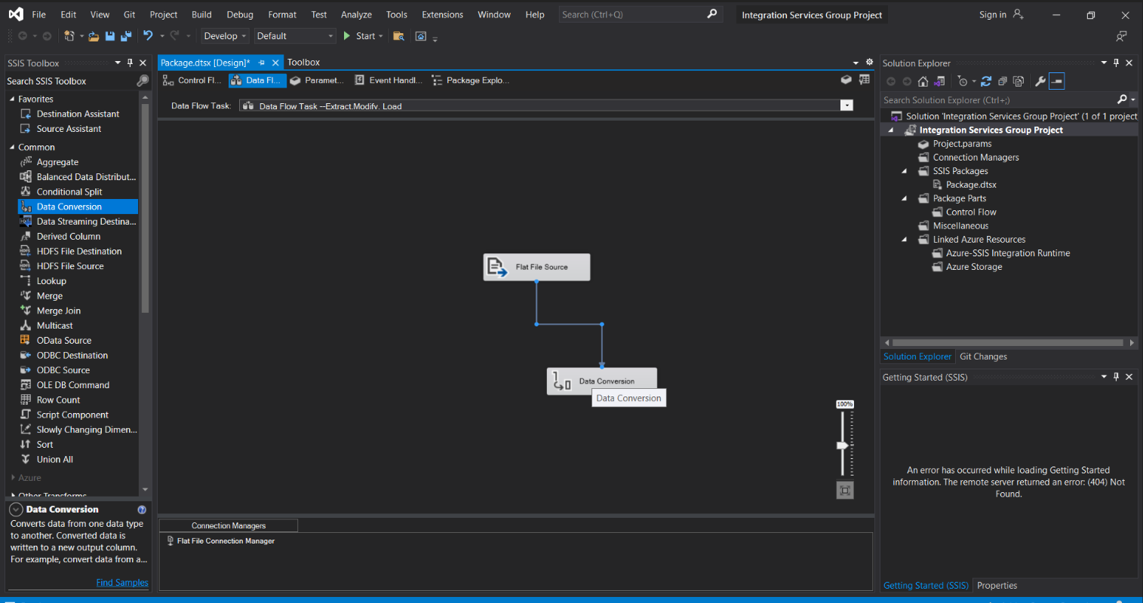
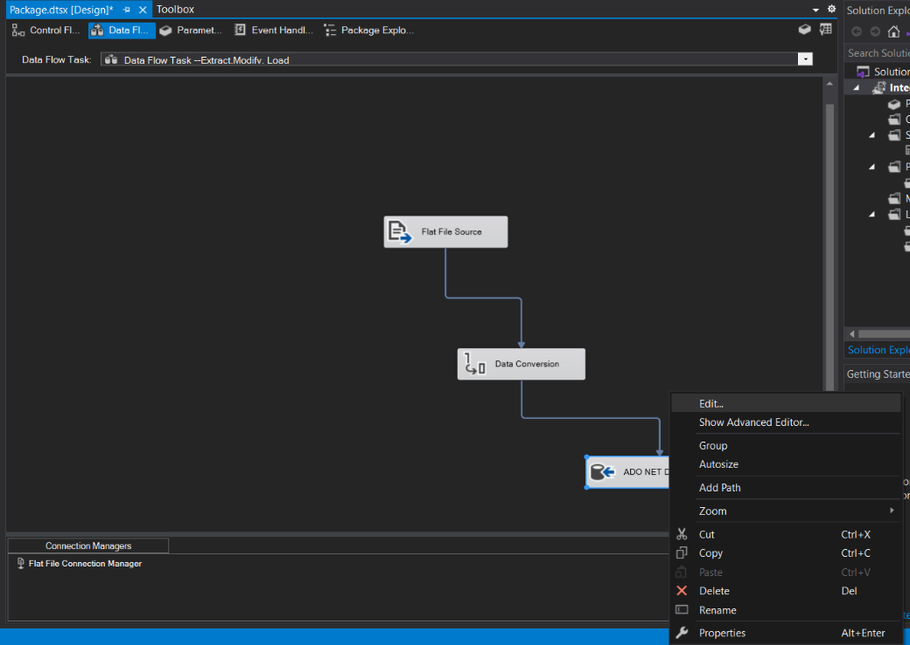
Data Flow Load in SSIS
In an SSIS task data flows and data conversion takes place.

Slide 8
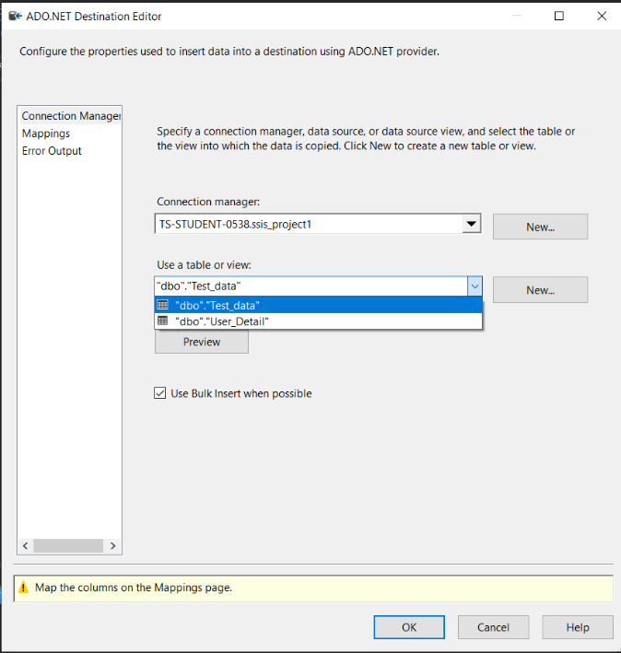
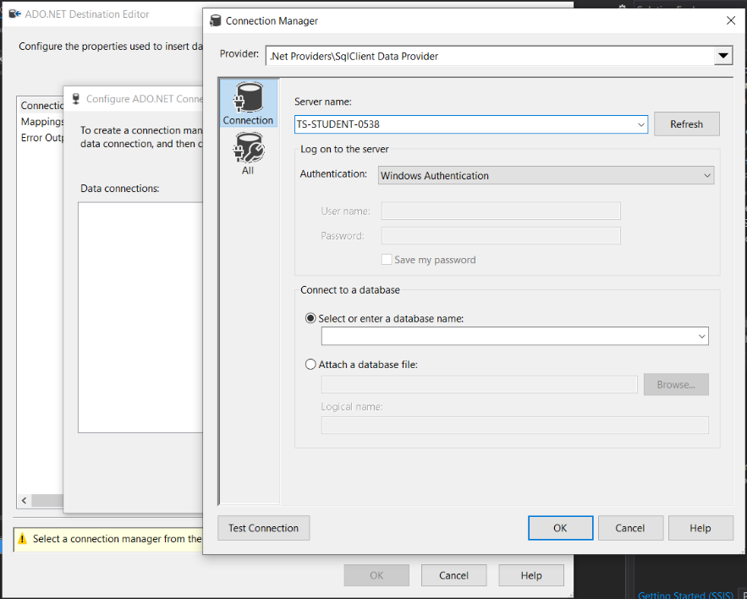
SSIS Connection Manager with Server
In an SSIS task data connection is built (from source) with the visual studio.

Slide 9
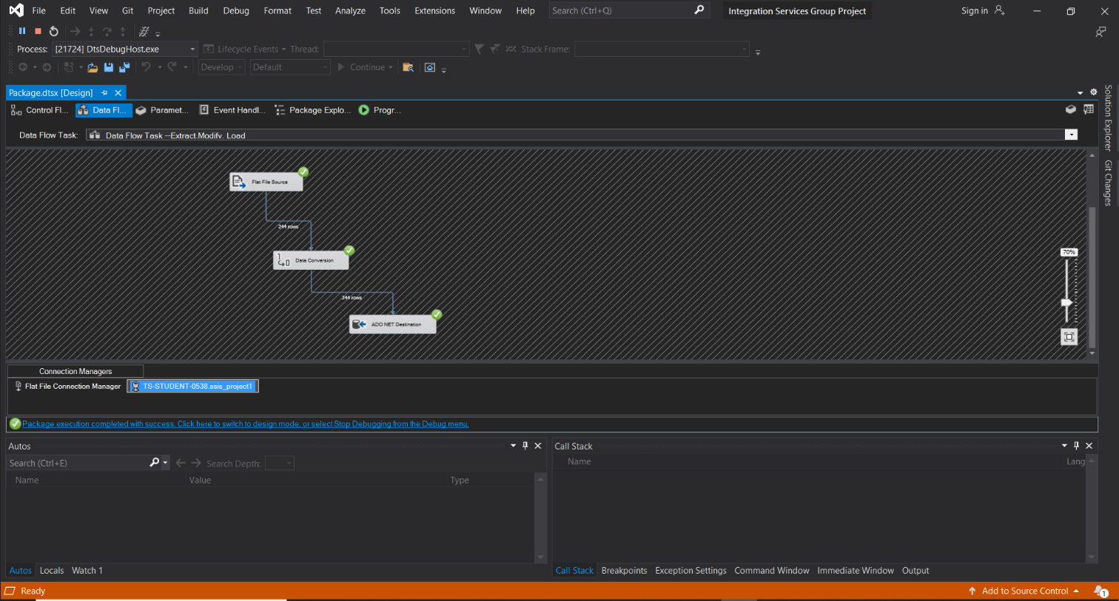
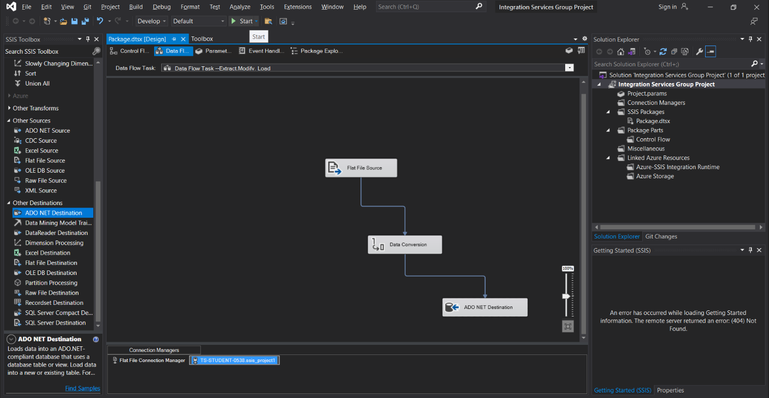
SSIS Connection Manager with Server
In an SSIS task data connection is built (destination) with the visual studio.

Slide 10
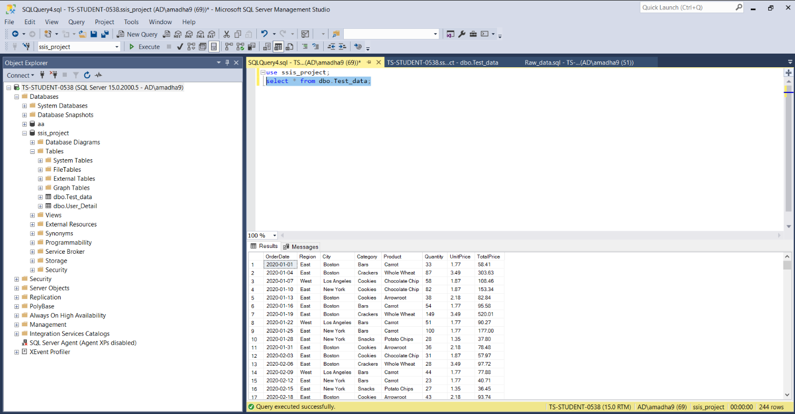
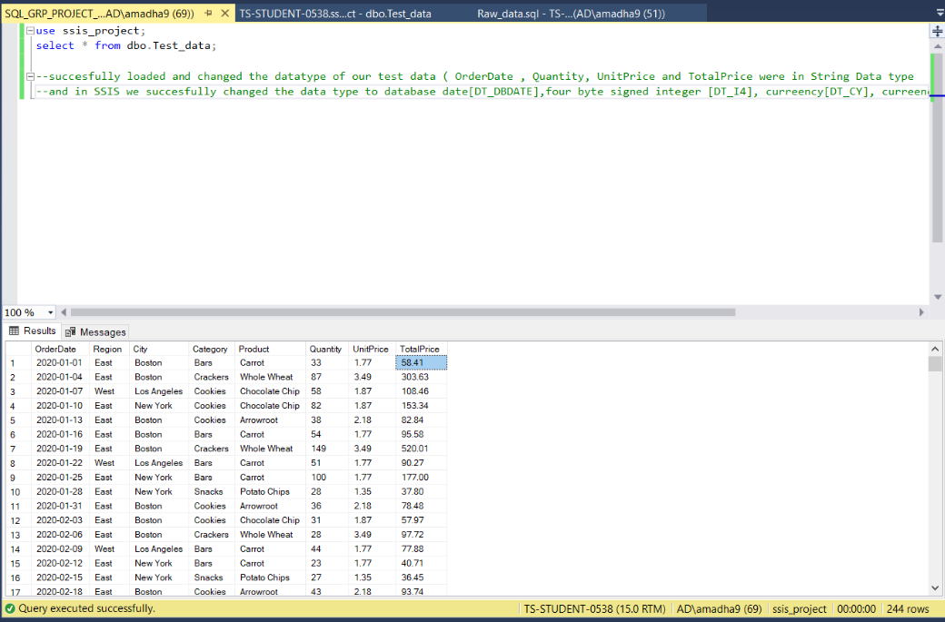
SSIS Connection Query Execution
Query Execution successfully loaded and changed the database and in SSIS successfully changed the data types

Slide 11
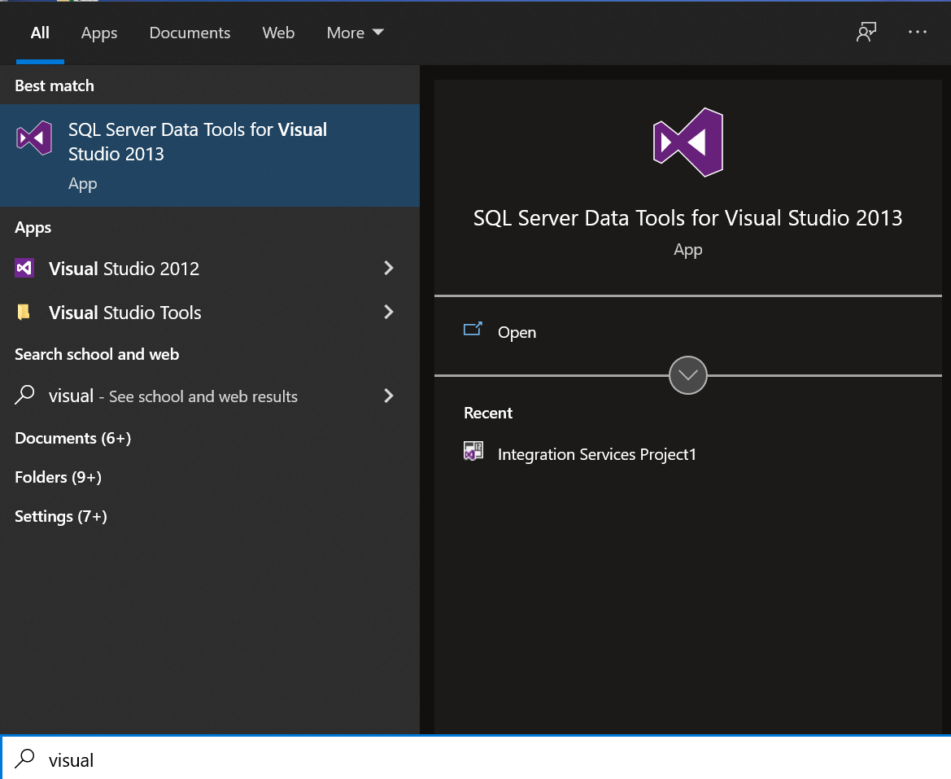
Create a New Project in SSAS
Search for Visual Studio
Hit Enter

Slide 12
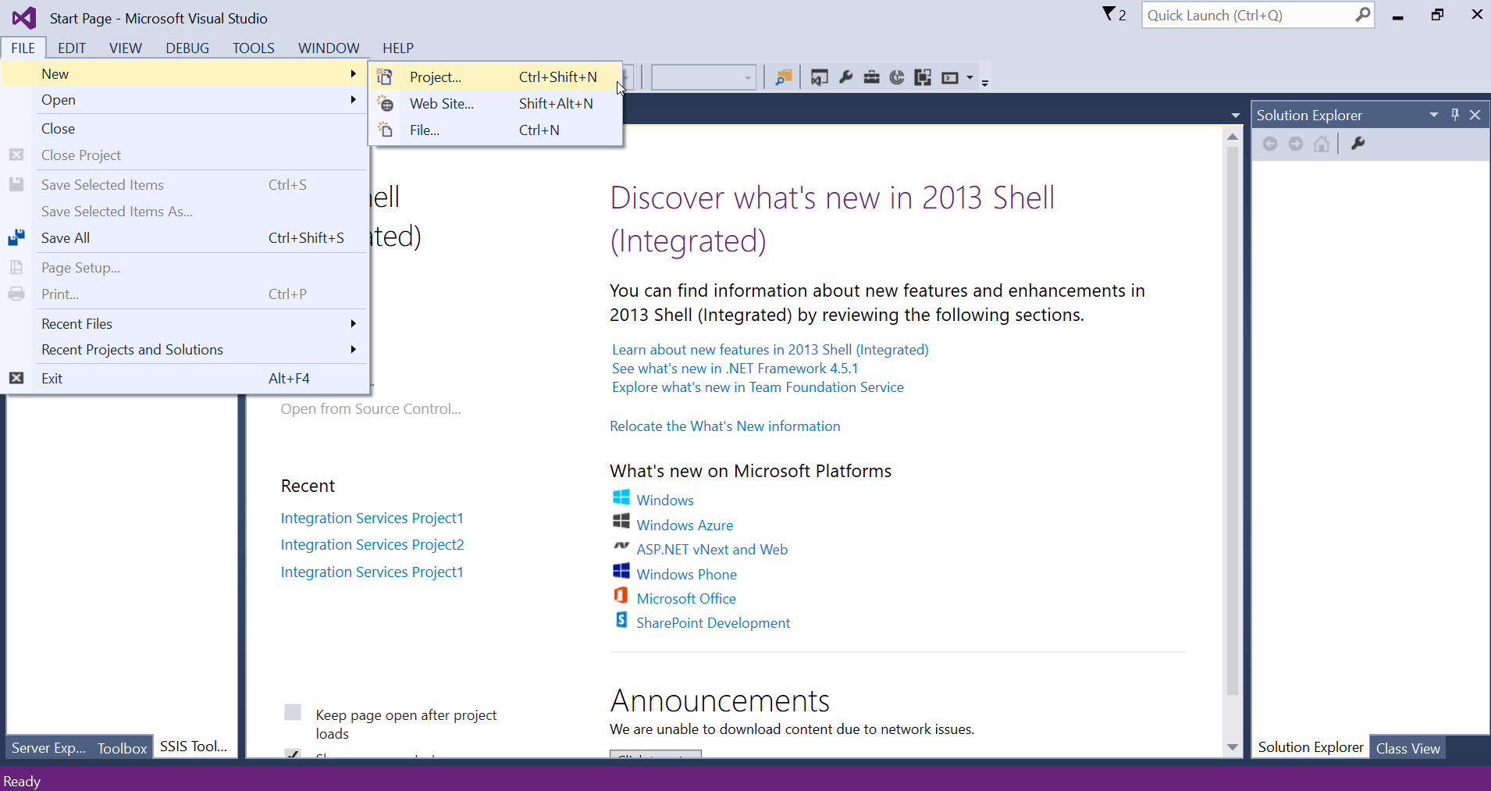
Create a New Project in SSAS
3. Click on File -> New -> Project

Slide 13
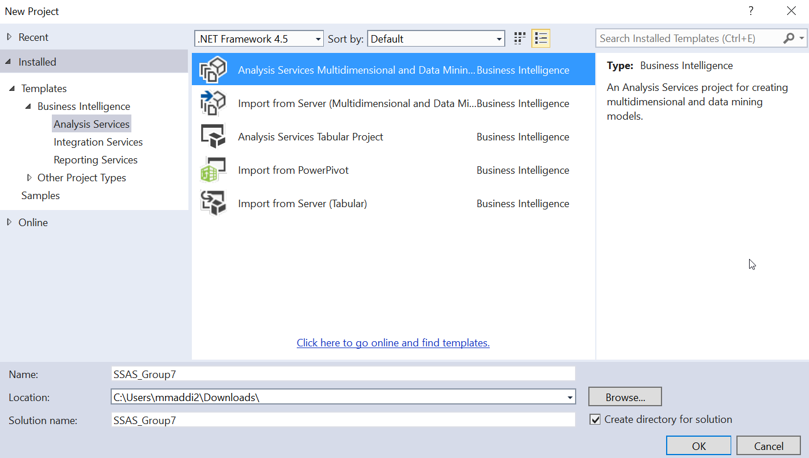
Create a New Project in SSAS
4. On the left-hand side, choose ‘Analysis Services’ under ‘Business Intelligence’
5. Then choose ‘Analysis Services Multidimensional and Data Minin..’
6. Give the name of the project and browse the location of the project.
7. Click on ‘OK’

Slide 14
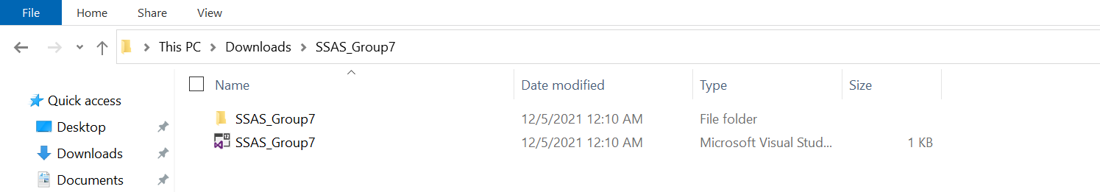
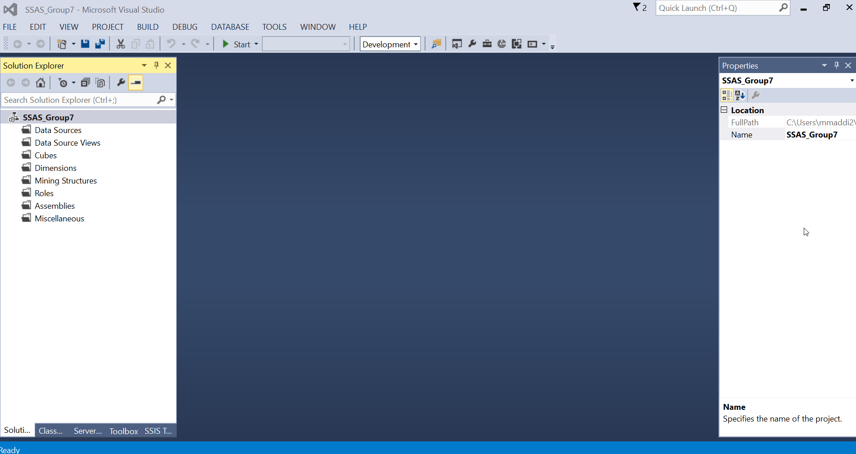
Create a New Project in SSAS
8. We can see that an Analysis Services project is created in the chosen location.
9. On Visual Studio, we can see Solution Explorer for the project created (SSAS_Group7)

Slide 15
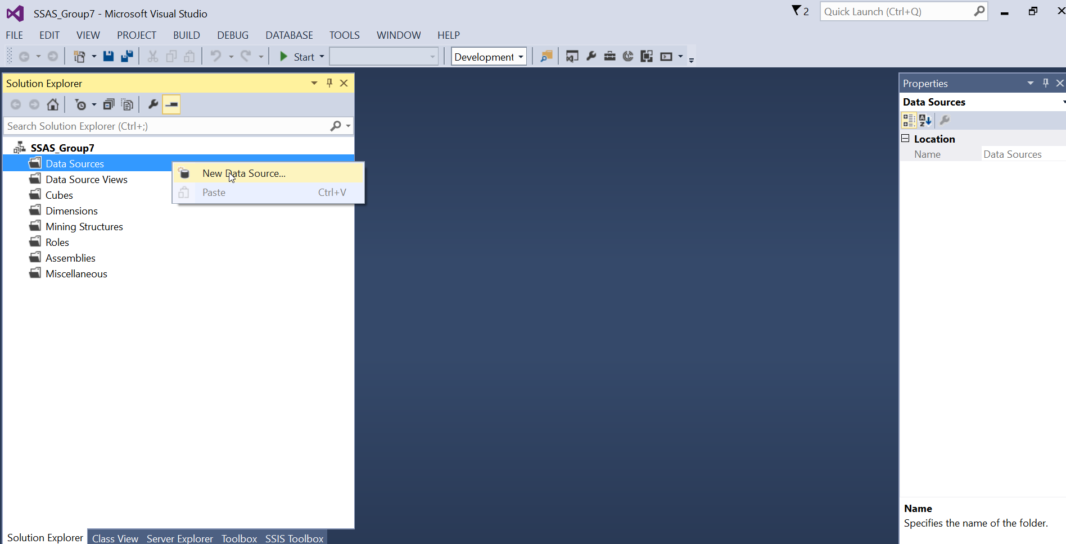
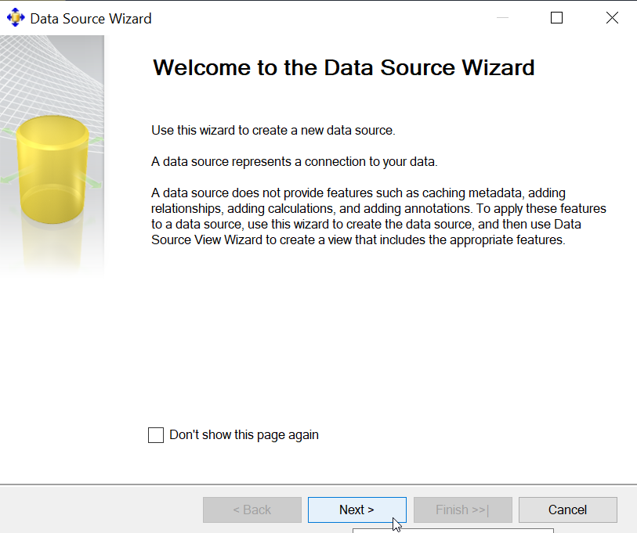
Create SSAS Data Source
1. Right click on ‘Data Sources’
2. Then choose ‘New Data Source’
3. In the ‘Data Source Wizard’ window, click on ‘Next’

Slide 16
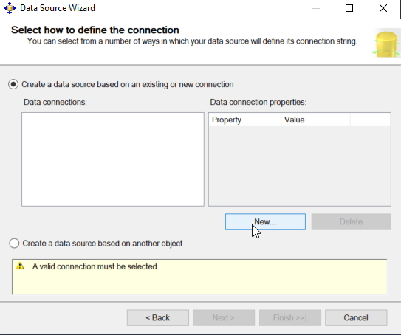
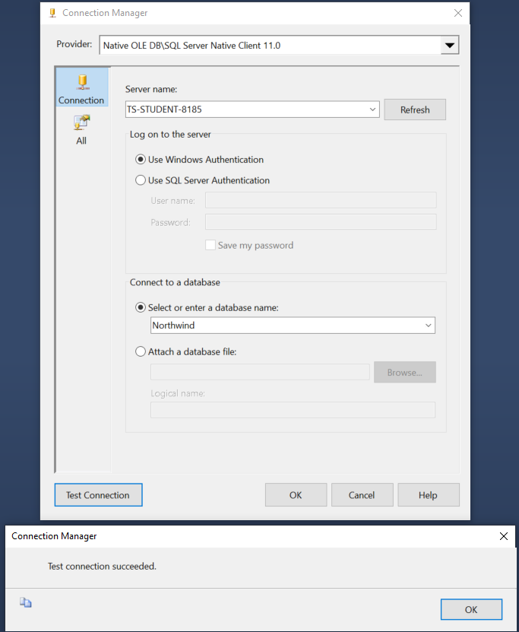
Create SSAS Data Source
4. Click on ‘New’
5. Select your ‘server name’ from the dropdown. Here the ‘Server name’ is ‘TS-STUDENT-8185’
6. Select ‘Use Windows Authentication’
7. Select the required database from the ‘database name’ dropdown. Here our database is ‘Northwind’
8. Click on ‘Test Connection’
9. If the test is successful, you will see a ‘Test Connection Succeeded’ message
10. Click on ‘OK’

Slide 17
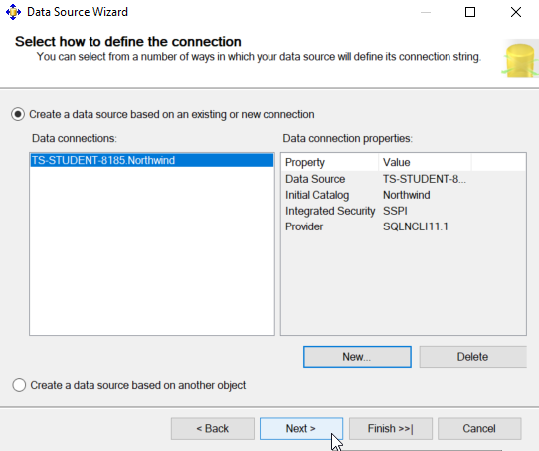
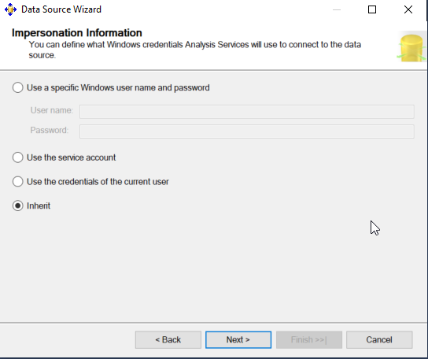
Create SSAS Data Source
11. Click on ‘Next’ in the ‘Data Source Wizard’ window
12. Choose ‘Inherit’ option for ‘Impersonation Information’
13. Click on ‘Next’

Slide 18
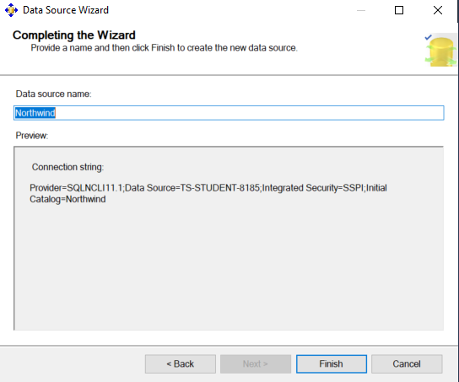
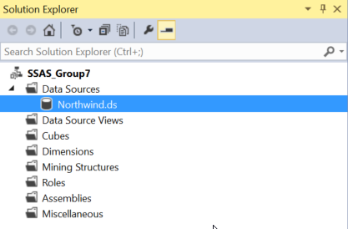
Create SSAS Data Source
14. Provide a name for your Data Source. Here the name is ‘Northwind’
15. Click on ‘Finish’
16. The newly created Data Source ‘Northwind.ds’ can be found in the Solution Explorer window

Slide 19
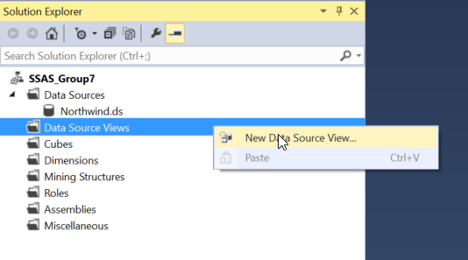
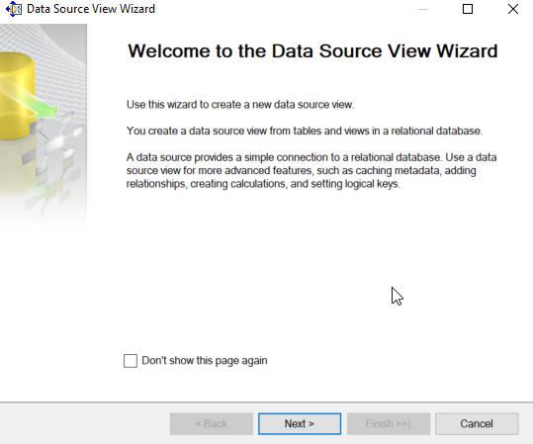
Create SSAS Data Source View
Right click on ‘Data Source Views’
Choose ‘New Data Source View’
Click on ‘Next’

Slide 20
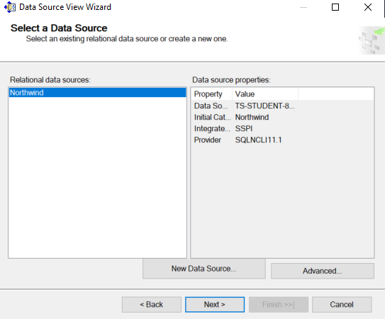
Create SSAS Data Source View
4. Choose ‘Relational data sources’
5. Click on ‘Next’

Slide 21
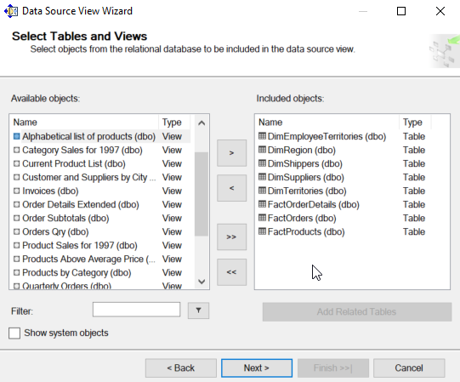
Create SSAS Data Source View
6. Select required Dimension and Fact tables for the analysis using right arrows
7. Click on ‘Next’

Slide 22
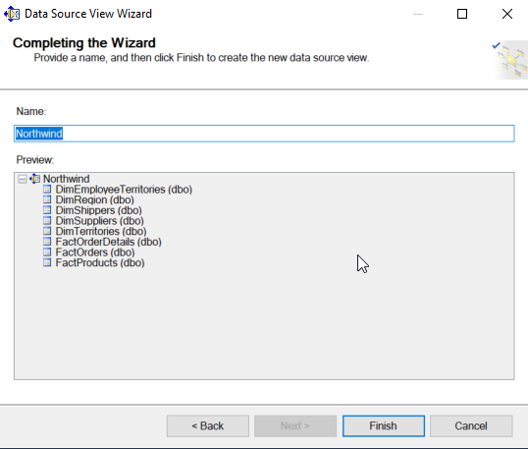
Create SSAS Data Source View
8. Provide a name for your Data Source View
9. Click on ‘Finish’

Slide 23
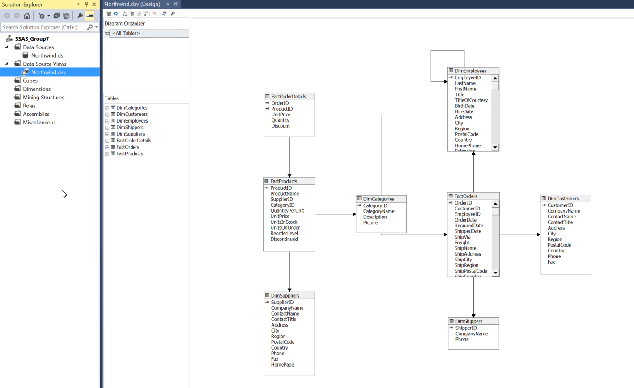
Create SSAS Data Source View
10. A new Data Source View is created
11. The diagram shows the relationship between different tables

Slide 24
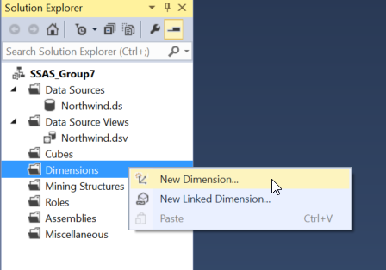
Create Dimension in SSAS
Right click on ‘Dimensions’
Choose ‘New Dimension’

Slide 25
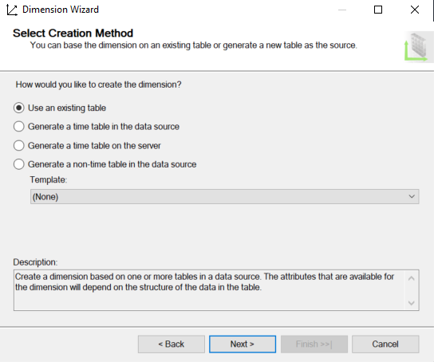
Create Dimension in SSAS
3. Select ‘Use an existing table’
4. Click on ‘Next’

Slide 26
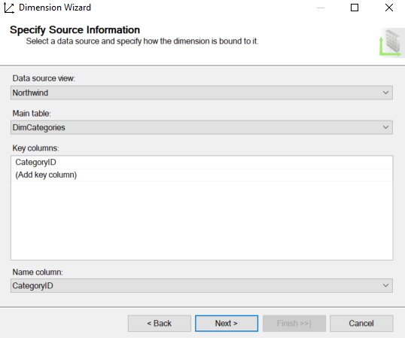
Create Dimension in SSAS
5. Choose your Data source view from the dropdown
6. Click on ‘Next’

Slide 27
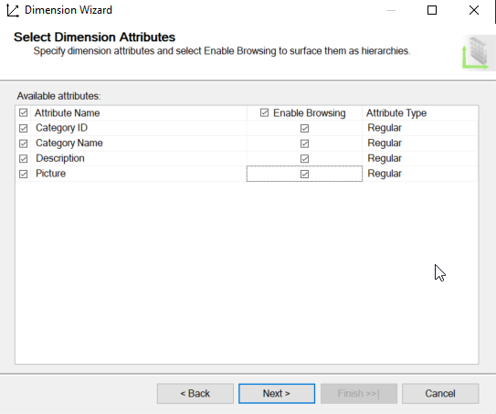
Create Dimension in SSAS
7. Select the required attributes
8. Click on ‘Next’

Slide 28
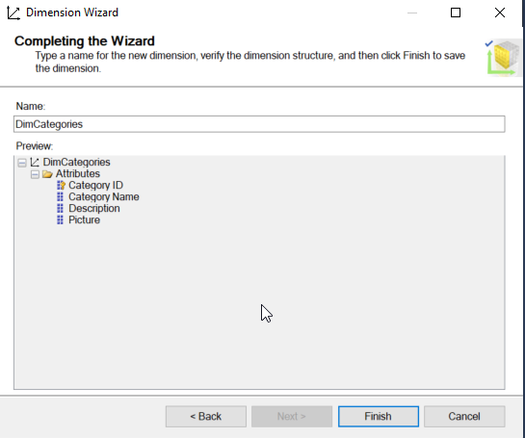
Create Dimension in SSAS
9. Provide appropriate name for the Dimension
10. Click on ‘Finish’

Slide 29
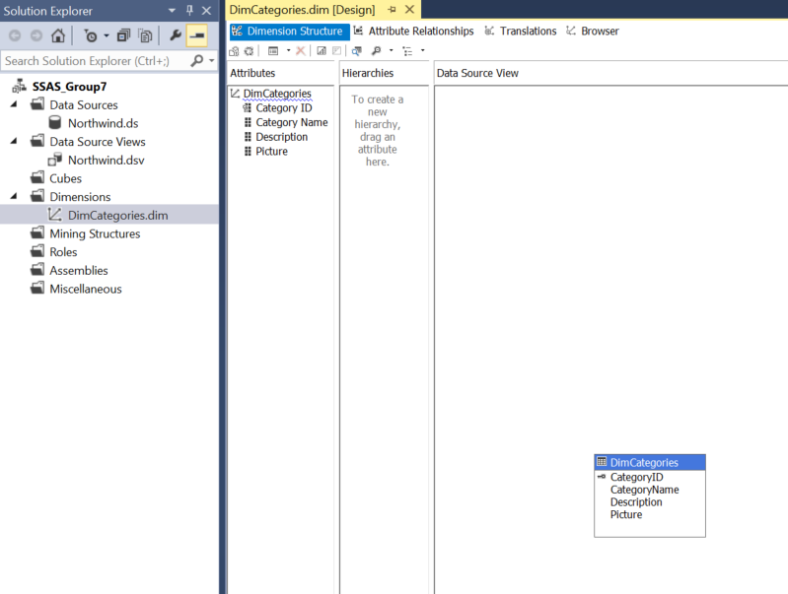
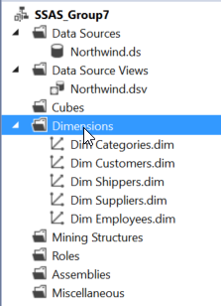
Create Dimension in SSAS
11. A new dimension ‘DimCategories.dim’ is created
12. Repeat the steps for all the Dimension tables

Slide 30
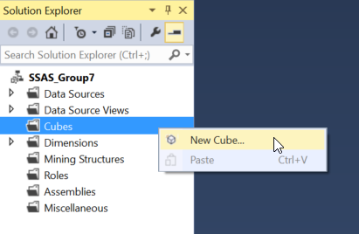
Create OLAP Cube in SSAS
Right click on Cubes
Choose ‘New Cube’

Slide 31
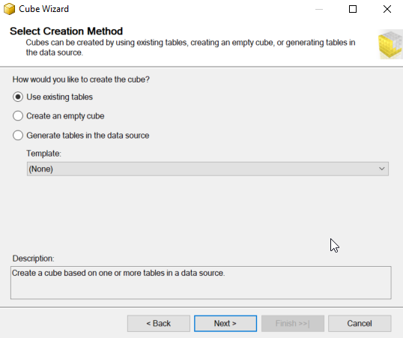
Create OLAP Cube in SSAS
3. Click on ‘Use existing tables’
4. Click on ‘Next’

Slide 32
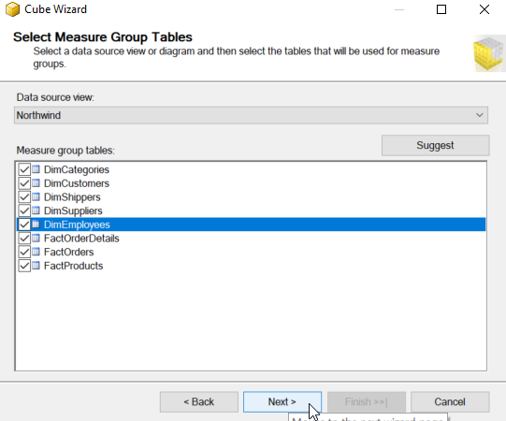
Create OLAP Cube in SSAS
5. In ‘Cube Wizard’ window, choose your Data source view from the dropdown
6. Click on ‘Next’

Slide 33
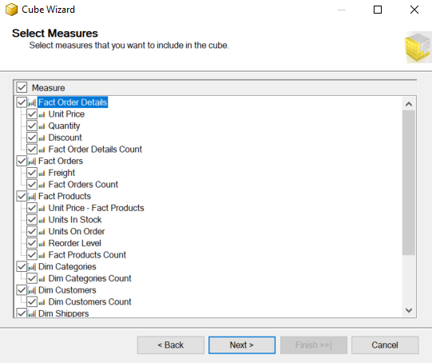
Create OLAP Cube in SSAS
7. Select the required measures to include in the cube
8. Click on ‘Next’

Slide 34
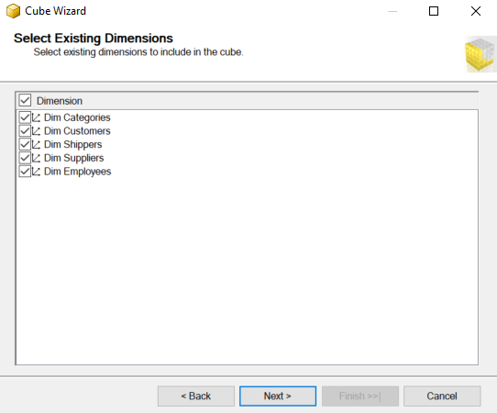
Create OLAP Cube in SSAS
9. Select the required dimensions to include in the cube
10. Click on ‘Next’

Slide 35
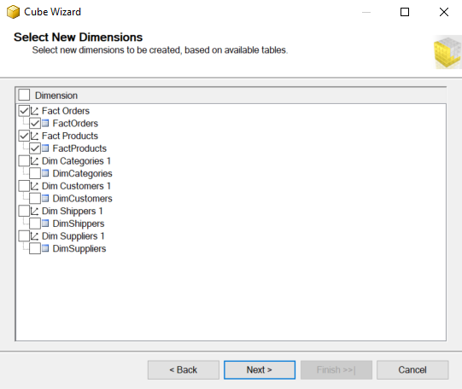
Create OLAP Cube in SSAS
11. Select if any new dimensions need to be created
12. Click on ‘Next’

Slide 36
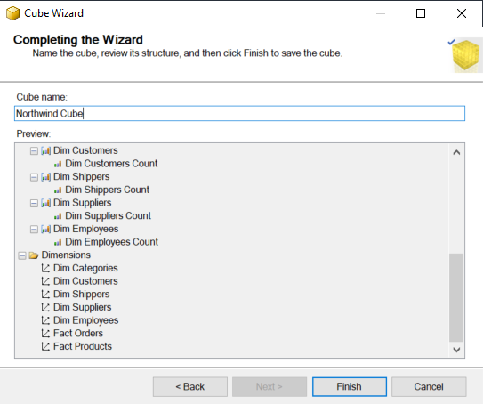
Create OLAP Cube in SSAS
13. Provide a name for your cube
14. Click on ‘Finish’

Slide 37

Create OLAP Cube in SSAS
15. A new cube solution is created
16. A design of the cube would be provided

Slide 38

Create Named Calculations in SSAS
1. Right click on the table that you want to create a new named calculation

Slide 39


Create Named Calculations in SSAS
2. Provide the name for the calculated column – ‘Revenue’
3. Write an expression to calculate Revenue
4. Click on ‘OK’
5. A new calculated column ‘Revenue’ is created

Slide 40

Create Measure in SSAS
1. Right click on the Measure under cube in which you want to create a New Measure

Slide 41


Create Measure in SSAS
2. Here, we can find the total number of units in stock.
3. Choose ‘Sum’ from the ‘Usage’ dropdown
4. We are creating a new measure in ‘FactProducts’ table
5. Choose the ‘UnitsInStock’ column
6. Click on ‘OK’
7. A new measure is created

Slide 42

Create a new project in SSRS
Click on File > New > Project

Slide 43

Create a new project in SSRS
Select reporting services > report server project

Slide 44

Creating a new report in SSRS
We select Reports folder from the solution explorer pane.

Slide 45

After naming the report, we get a design and preview tab.
We will now add elements to the report.

Slide 46

Configuring the Data Source in SSRS
We select ‘New’ from the Report Data Pane.

Slide 47

We name the dataset and click ‘new’ under Data Source to configure a connection to our SQL Server.

Slide 48

We name the configuration and select “Microsoft SQL Server” under Type.
The connection string will consist
of the data source which is the url
of the hosted SQL Server instance;
as well as the name of the
database.

Slide 49
We then write the query logic for the reporting structure under “Query”

Slide 50

Adding elements to the report in SSRS
To display information from our reporting query, we must add a table.
For this, we navigate to the toolbox pane and drag and drop “Table” in the design surface.

Slide 51


Adding information to tables in SSRS
We drag and drop columns from the dataset to the design surface in the respective table columns.
We can then go into the preview tab to see our results.

Slide 52


Formatting information in SSRS
Right click the info area of the desired column and click Text Box properties.
Then we go into number and select the correct category and format.

Slide 53

Grouping totals in SSRS
In order to show sums or other aggregate function we must define row grouping.
For this, we drag and drop the Details column into Row Groups.

Slide 54


Multiple group totals in SSRS
In order to show multiple totals in the report as a derived measure, we must create the appropriate hierarchy.
So we drag and drop the Order column to be the parent of the Details column.

Slide 55


Formatting Text Areas in SSRS
In order to format cells of the table displaying information we must select the info area part of the desired column
Then hit Format from the toolbar above. Then select background colour and the appropriate colour.

